Slide 1

Foundations of Artificial Intelligence
UNIT-II
Statistics for Machine Learning

Slide 2
Introduction
Most Intelligent Systems have some degree of uncertainty associated with them
Uncertainty in systems arises primarily because of problems in data, major causes being that data is missing or unavailable, data is present but unreliable or ambiguous due to errors in measurement, presence of multiple conflicting measurements and so on
It is not always possible to represent data in a precise and consistent manner, data is generally based on defaults, which may have exceptions leading to errors in intelligent systems
Uncertainty may also be caused by the represented knowledge since it might represent only the best guesses of the expert based on observations or statistical conclusion, which may not be appropriate in all situations
Hence, Uncertainty management is incorporated in Intelligent Systems
Uncertain information can be handled by Probability Theory, Fuzzy Logic, model and temporal logic

Slide 3
Probability Theory
Used to estimate the degree of uncertainty
Oldest method with strong mathematical basis
Probability is defined as a way of turning an opinion or an expectation into a
number lying between 0 and 1
It reflects the likelihood of an event
Assume a set S (sample space) consisting of independent events representing all possible outcomes of a random experiment
Probability of an event A, P(A)= ( Number of outcomes favourable to A)
(Total number of possible outcomes)
Probability of all events { A₁,A₂, …, A_{n}}, must sum up to certainty, i.e.
P(A₁)+P(A₂)+…+P(A_{n}) = 1
Impossible event has probability of 0, while a certain event has a probability 1

Slide 4
Axioms of Probability
If S represents a sample space and A and B represent events, then the following axioms
hold true, A΄ represents complement of set A
P(A) ≥ 0
P(S) = 1
P(A΄) = 1 – P(A)
P(A ⋃ B)=P(A) + P(B) , if events A and B are mutually exclusive
P(A ⋃ B)=P(A) + P(B) – P( A ⋂ B), if A and B are not mutually exclusive. It is called
addition rule of probability

Slide 5
Joint Probability
Joint Probability is defined as the probability of occurrence of two independent events in conjunction i.e. Joint probability refers to the probability of both events occurring together written as P(A ⋂ B) or P( A and B)
P(A and B)=P(A) * P(B)
Two events are said to be independent if the occurrence of one event does not affect the probability of occurrence of the other
P ( A or B) = P(A) + P(B) - P(A) * P(B)
P(A) = P(A and B) + P(A and B΄)=0.20+0.65=0.85 P(B) = P(A and B) + P(A΄ and B)=0.20+0.12=0.32 P(A or B) = P(A) + P(B) - P(A and B)
= P(A and B) + P(A and B΄) + P(A and B)+P(A΄ and B) - P(A and B)
= P(A and B΄) + P(A and B)+P(A΄ and B)
= 0.65+0.20+0.12=0.97
or
P(A or B) = 1 – P((A or B)΄)= 1 – P(A΄ and B΄)=1-0.03=0.97
Joint Probabilities | A | A΄
B | 0.20 | 0.12
B΄ | 0.65 | 0.03

Slide 6
Conditional Probability
Probability of an event can depend on the probability of another event
The concept of conditional probability relates the probability of one event to the
occurrence of another event
It is defined as the Probability of the occurrence of an event H (hypothesis) provided an event E( evidence) is known to have occurred.
It is denoted by P(H | E)
P(H | E) = Number of events favourable to H which are also favourable to E Number of events favourable to E
= P(H and E)
P(E)
If events H and E are independent, then P( H | E) = P(H) and P( E | H ) = P(E)

Slide 7
Conditional Probability
Example: Probability of a person chosen at random being literate is 0.40 and probability of any person chosen at random having age > 60 years as 0.005. Find the probability of the fact that a person chosen at random of age > 60 is literate
Solution:
P(X is literate and age of X >60) = P(X is literate) * P(age of X>60) =0.40*0.005=0.002
Probability that a person chosen at random having age > 60 years is literate: P(X is literate | age of X >60) = P(X is literate and age of X >60 )
P(age of X >60)
= 0.002 = 0.4
0.005

Slide 8

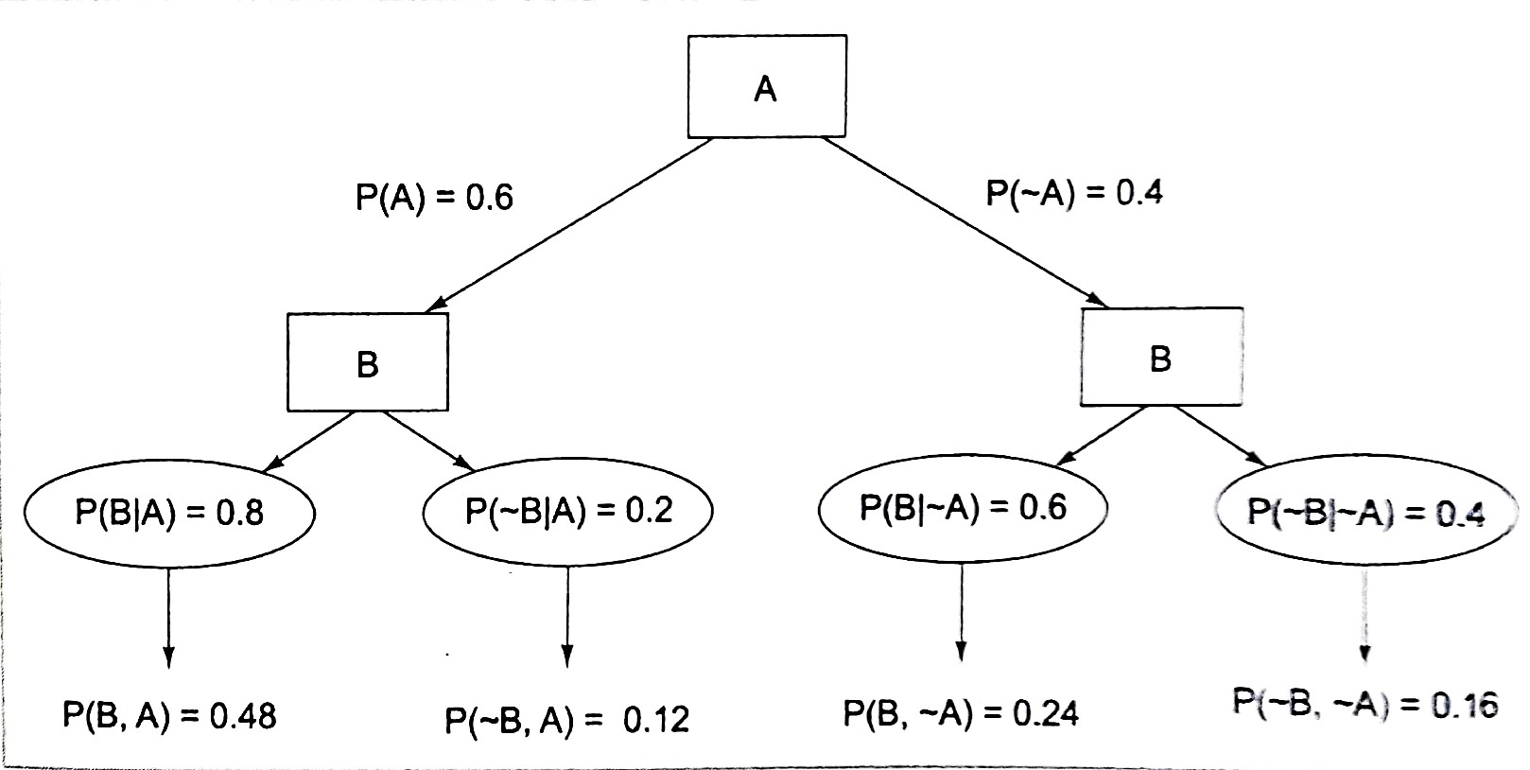
Conditional Probability
Example: A: Sun is bright today and B : Sun will be bright tomorrow Given P(sunny_today) = 0.6 , P(sunny_tomorrow | sunny_today) = 0.8
Joint Probability Distribution

Slide 9
Bayes’ Theorem
Developed in 1763 by Thomas Bayes
It provides a mathematical model for reasoning where prior beliefs are combined with evidence to get estimates of uncertainty
It relies on the concept that one should incorporate the prior probability of an event into the interpretation of a new situation
Bayes’ theorem can be written as :
P(H|E) = P(E|H) * P(H)
P(E)

Slide 10
Proof of Bayes’ Theorem
Using Conditional Probability, P(H|E) = P(H and E) / P(E)
=> P(H|E) * P(E) = P(H and E)
Similarly,
P(E|H) = P(E and H) / P(H)
=> P(E|H) * P(H) = P(E and H )
From (1) and (2),
---(1)
---(2)
P(H|E) * P(E) = P(E|H) * P(H)
Hence we obtain,
P(H|E) = P(E|H) * P(H) => Bayes’ Theorem P(E)

Slide 11
Bayes’ Theorem
P(H|E) = P(E|H) * P(H)
P(E|H) * P(H) + P(E|~H) * P(~H)
As P(E) = P(E and H) + P(E and ~H) Using Conditional Probability, we obtain, P(E and H) = P(E|H) *P(H)
P(E and ~H) = P(E|~H) *P(~H)
Therefore P(E) = P(E|H) *P(H) + P(E|~H) *P(~H)
P(H) is the prior probability of H
P(H|E) is known as the conditional probability of H, given E
P(E|H) is known as the conditional probability of E, given H
P(E) is the prior probability of E and acts as a normalizing constant

Slide 12
Bayes’ Theorem Example
Suppose we are given the probability of Mike has a cold as 0.25, the probability of Mike was observed sneezing when he had cold in the past was 0.9 and the probability of Mike was observed sneezing when he did not have cold as 0.20. Find the probability of Mike having a cold given that he sneezes.
Sol. H : Mike has a cold, P(H)=0.25
E : Mike sneezes, P(H|E) to be calculated
P(Mike was observed sneezing | Mike has a cold) =P(E|H) = 0.9
P(Mike was observed sneezing | Mike does not have a cold) = P(E|~H)=0.2 P(Mike has a cold | Mike was observed sneezing) =P(H|E)
P(H|E) = P(E|H) * P(H) = 0.9 *0.25 = 0.225 = 0.6 P(E|H) * P(H) + P(E|~H) * P(~H) 0.9*0.25+0.2*0.75 0.375
Similarly
P(H|~E) =[P(~E|H)*P(H)]/P(~E) = [(1-0.9) *0.25] /(1-0.375) =0.025/0.625=0.04

Slide 13
Extension of Bayes’ Theorem
One Hypothesis and Two Evidences
Consider a given hypothesis H and two evidences E1 and E2 P(H | E1 and E2) = P(E1|H) * P(E2|H) * P(H)
P(E1 and E2)
We can derive different forms of the formula : Form 1:
P(H | E1 and E2) = P(H) * P(E1|H) * P(E2|H and E1)
P(E1) *P(E2|E1)
Form 2:
P(H | E1 and E2) = P(E2|H and E1) * P(H|E1)
P(E2|E1)

Slide 14
Extension of Bayes’ Theorem
One Hypothesis and Multiple Evidences
Consider a given hypothesis H and n evidences
P(H | E1 and …and En) = P(H and E1 and … and En)
P(E1 and … and En) P(H | E1, … , En) = P(H, E1, …, En)
P(E1, …,En)
Bayes’ theorem to express conditional probability involving n>2 evidences which are assumed to be independent of each other is defined as :
P(H | E1, … En) = P(E1|H)* … *P(En|H) *P(H)
P(E1, …, En)
Chain Evidence :
If E1 is an evidence of H and E2 is an evidence of E1, P(H|E1) = P(E1|H) * P(E2|E1) * P(H)
P(E1|E2)*P(E2)

Slide 15
Extension of Bayes’ Theorem
Multiple Hypotheses and Single Evidence
Consider a set of hypotheses {H1,H2,…,Hk} and evidence E P(Hi | E) = P(E |Hi ) * P(Hi)
P(E)
Another definition is :
P(E) =∑^{𝑘} P(E |Hj) ∗ P(Hj)
𝑗=1
P(Hi | E) = P(E |Hi ) * P(Hi)
∑𝑘
P(E |Hj) ∗ P(Hj)
𝑗=1
Multiple Hypotheses and Multiple Evidences
Consider a set of hypotheses{H1,H2,…,Hk} and multiple sources of evidence
{E1,E2,…,En}
P(Hi | E1,…,En) = P(E1,…,En |Hi ) * P(Hi)
∑𝑘
P(E1,…,En|Hj) ∗ P(Hj)
𝑗=1

Slide 16
Probabilities in Rules and Facts of Rule-Based System
A fact ‘battery in a randomly picked computer is dead 2% of the time’ can be expressed in Prolog as battery_dead_computer(0.02)
The rule ‘The probability of the battery being dead is same as the probability of the circuit being faulty’ may be written in Prolog as
battery_dead_computer(P) :- computer_circuit_faulty(P) To ignore weak evidences, we can write as:
battery_dead_computer(P) :- computer_circuit_faulty(P) , P > 0.1
The rule ‘If 30% of the time when a computer has a circuit problem, the battery
is dead’ can be written as:
battery_dead_computer(P) :- computer_circuit_faulty(P1) , P1 =0.3

Slide 17
Cumulative Probabilities
It is very important to combine the probabilities from the facts and successful rules to get a cumulative probability
Two situations might arise:
If sub-goals of a rule are probable, then the probability of the rule to succeed should take care of the probable sub goals
If rules with the same conclusion have different probabilities, then the overall probability of the rule has to be found
Prob(A and B and C and …) = Prob(A)*Prob(B)*Prob(C)* …
Prob(A or B or C or …) = 1 – [(1-Prob(A))(1-Prob(B))(1-Prob(C)) …]

Slide 18
Prolog Programs for Computing Cumulative Probabilities
AND-combination: A list of all the probabilities is passed as an argument and the product of all these probabilities is computed to obtain and-combination effect using Prolog rules as follows:
Prob(A and B and C and …) = Prob(A)*Prob(B)*Prob(C)* … and_combination([P],P)
and_combination([H|T],P) :- and_combination(T,P1), P is P1*H
The rule ‘when a computer has a circuit problem and the battery is old , then the battery is dead’
battery_dead_computer(P):-computer_circuit_faulty(P1),battery_old(P2), P is P1*P2 battery_dead_computer(P):-computer_circuit_faulty(P1), battery_old(P2),
and_combination([P1,P2],P)

Slide 19
Prolog Programs for Computing Cumulative Probabilities
OR-combination:
Prob(A or B or C or …) = 1- [(1-Prob(A))(1-Prob(B))(1-Prob(C))…] or_combination([P],P)
or_combination([H|T],P) :- or_combination(T,P1), P is 1-((1-H)*(1-P1))
overall(P) :- findall(Prob, pred(Prob),L), or_combination(L,P)
containing all the probabilities for which predicate is satisfied Example: compute(0.4) :- a
compute(0.5) :- b, c
compute(0.2) :- a, d
where L is List
overall_compute(P) :- findall(P1,compute(P1),L),or_combination(L,P) L=[0.4,0.5,0.2] , P =(1-0.6*0.5*0.8) = 0.760

Slide 20
Handling Negative Probabilities
Probable sub goals in rules which are not true can cause problems if not handled properly
For example the rule: g(P) :- a(P1),b(P2),not(c(P3)) where a,b,c are all certain
subgoals
If the rule is 80% probable, then cumulative probabilities cannot be calculated using and_combination
Hence the rule can be rewritten as:
g(P) :- a(P1),b(P2),not(c(P3)), inverse(P3,P4), and_combination([P1,P2, P4,0.8],P)
inverse(P,Q) :- Q is 1-P

Slide 21
Rule-Based System Using Probability: Example
A simple rule-based system for the diagnosis of malfunctioning of some equipment, for eg. a landline telephone
Following could be the reasons for the malfunctioning of telephones:
Faulty instrument
Problem in Exchange
Broken Cable
Rules regarding Faulty Telephone Instrument
Rule 1: If the telephone instrument is old and has been repaired several times in the past then it is 40% sure that the fault lies with the instrument. In Prolog:
telephone_not_working(0.4) :- ask(tele_history)

Slide 22
Rule-Based System Using Probability: Example
Rules regarding Faulty Telephone Instrument
Rule 2: If the instrument has fallen on the ground and broken, then it is 80% sure that the fault lies with the instrument. In Prolog:
telephone_not_working(0.8) :- ask(telephone_broken)
Rule 3: If there are children in the house who play with the keypad of the telephone, with some probability, then it is 80% sure that the instrument is faulty because of excessive and unusual usage. In Prolog:
telephone_not_working(P):-ask(children_present,P1), ask(children_keypad,P2),
and_combination([P1,P2,0.8],P)
Cumulative probability for telephone not working because of fault of instrument, the
instrument_faulty(P) :- findall(X,telephone_not_working(X),L),
or_combination(L,P)
rule is :

Slide 23
Rule-Based System Using Probability: Example
Rules for diagnosis of Instrument fault
The rule for diagnosis based on instrument fault which we assume to be 70% sure can be written as:
diagnosis(‘Instrument is faulty’, P) :- instrument_faulty(P1),
and_combination([P1,0.7],P)

Slide 24
Bayesian Method: Advantages and Disadvantages
Advantages
Bayesian method is based on a strong theoretical foundation in probability theory, it is currently the most advanced of all certainty methods
This method has well-defined semantics for decision making
Disadvantages
The system using Bayesian approach needs quite a large amount of probability data to construct a knowledge base
Since conditional probabilities are based on statistical data, the sample sizes must be sufficient to ensure that the probabilities obtained from them are accurate
If conditional probabilities are based on human experts, then the question of values being consistent and comprehensive arises

Slide 25
Bayesian Method: Advantages and Disadvantages
Disadvantages
Since associations between the hypotheses and evidences are reduced to numbers, it eliminates the actual knowledge embedded within the data. Therefore, a system’s ability to explain its reasoning and browsing through the hierarchy of evidences to hypothesis to a user is lost
In spite of these problems, Bayesian theory provides an attractive basis for an uncertain reasoning system. Other mechanisms developed to utilize the power of this theory and ease of its implementation are:
Bayesian Belief Networks
Certainty Factor Theory
Dempster-Shafer Theory

Slide 26
Bayesian Belief Networks(BBN)
Joint probability requires 2^{n} entries for n variables to store the distribution explicitly
The time and storage requirements for such computations become impractical as the value of n increases
Bayesian Belief Network is a probabilistic graphical model that encodes probabilistic relationships among a set of variables with their probabilistic dependencies
It is an efficient structure for storing joint probability distribution
Only one branch of the tree needs to be traversed in the network
It may be formally defined as an acyclic directed graph where the nodes of the graph represent evidence or hypotheses and an arc connecting two nodes represents dependence between them

Slide 27
Bayesian belief network is key computer technology for dealing with probabilistic events and to solve a problem which has uncertainty.
"A Bayesian network is a probabilistic graphical model which represents a set of variables and their conditional dependencies using a directed acyclic graph.“
It is also called a Bayes network, belief network, decision network, or Bayesian model.
Bayesian networks are probabilistic, because these networks are built from a probability distribution, and also use probability theory for prediction and anomaly detection.
Real world applications are probabilistic in nature, and to represent the relationship between multiple events, we need a Bayesian network.
Applications:
Prediction,
anomaly detection,
diagnostics,
automated insight,
reasoning,
time series prediction, and
decision making under uncertainty.

Slide 28
Bayesian Network can be used for building models from data and experts opinions, and it consists of two parts:
Directed Acyclic Graph
Table of conditional probabilities.
The generalized form of Bayesian network that represents and solve decision problems under uncertain knowledge is known as an Influence diagram.
A Bayesian network graph is made up of nodes and Arcs (directed links),
Each node corresponds to the random variables, and a variable can be continuous or discrete.
Arc or directed arrows represent the causal relationship or conditional probabilities between random variables. These directed links or arrows connect the pair of nodes in the graph.
The Bayesian network has mainly two components:
Causal Component
Actual numbers
Each node in the Bayesian network has condition probability distribution P(X_{i} |Parent(X_{i}) ), which determines the effect of the parent on that node.

Slide 29
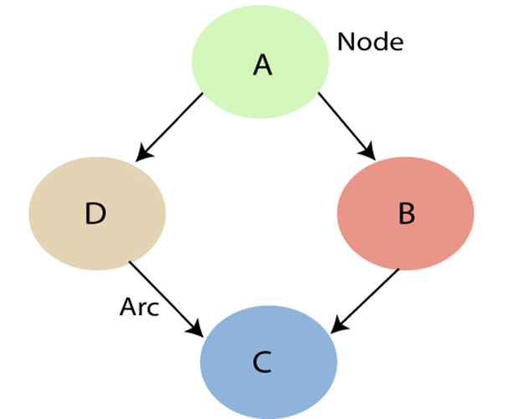
These links represent that one node directly influence the other node, and if there is no directed link that means that nodes are independent with each other
In the above diagram, A, B, C, and D are random variables represented by the nodes of the network graph.
If we are considering node B, which is connected with node A by a directed arrow, then node A is called the parent of Node B.
Node C is independent of node A.

Slide 30
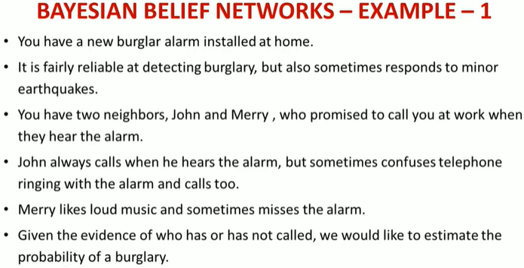

Slide 31
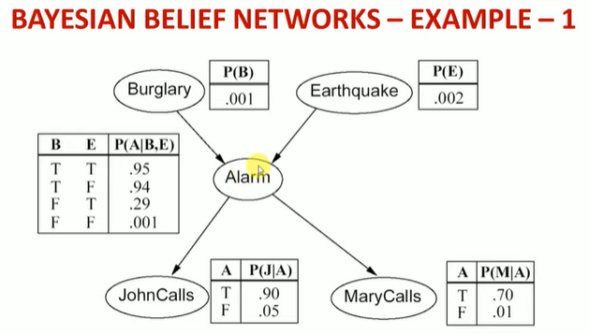

Slide 32
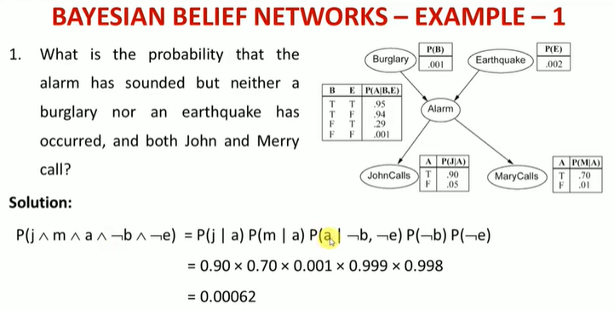

Slide 33
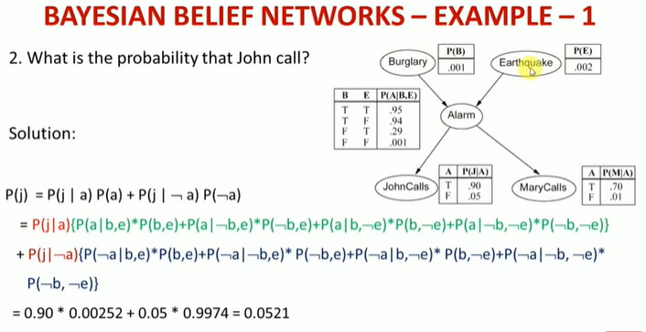

Slide 34
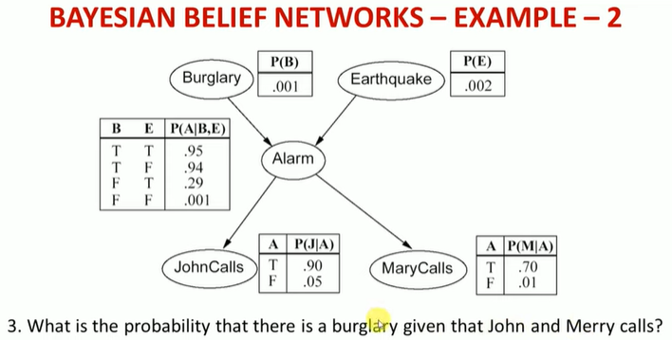

Slide 35
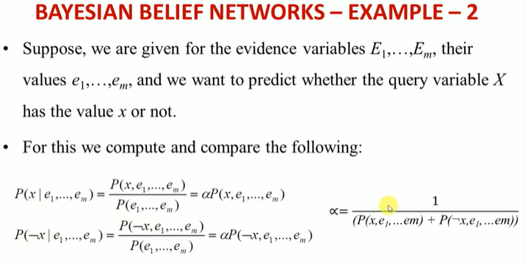
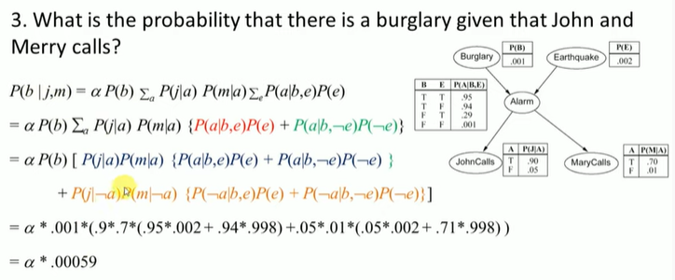

Slide 36
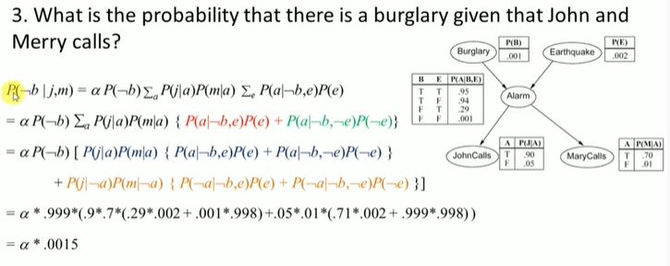
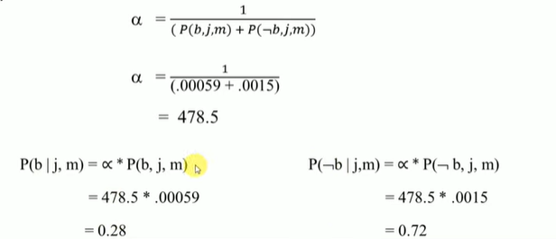

Slide 37
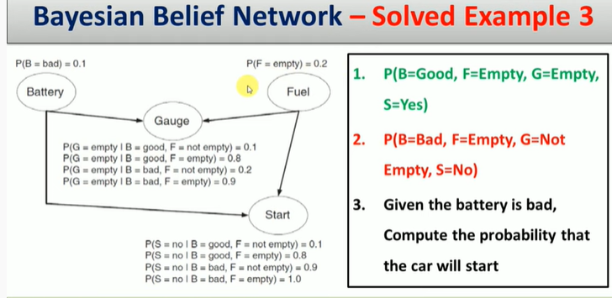

Slide 38
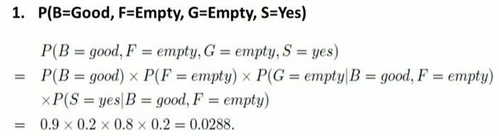
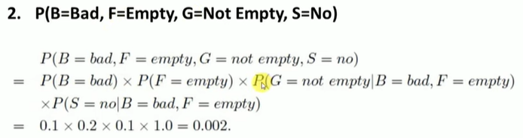

Slide 39
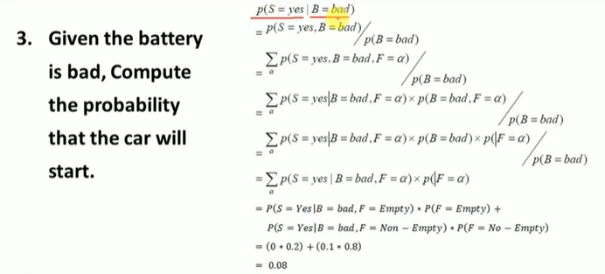

Slide 40



Bayesian Belief Networks(BBN)
Joint probability of n variables (dependent or independent) may be computed as P(X1,…,Xn) = P(Xn|X1,…Xn-1) *P(X1,…,Xn-1) or
P(X1,…,Xn) = P(Xn|X1,…Xn-1) *P(Xn-1|X1,…,Xn-2)*…* P(X2|X1)*P(X1)
In BBN, Joint Probability Distribution can be written as :
P(X1,…,Xn) = ∐^{n} P(Xi | parent_nodes(Xi))
i=1
The nodes having parents are called conditional nodes, if the value of a node is observed , then the node is said to be an evidence node
Nodes with no children are termed as hypotheses nodes, while nodes with no parents are called independent and unconditional nodes
Bayesian Belief Network
A
B
C
D

Slide 41
Bayesian Belief Networks(BBN)
For Example:
Conditional Probability Table
P(A)
P(B)
P(C|A) P(C|~A) P(D|A,B)
=0.3
=0.6
= 0.4
= 0.2
= 0.7
P(A) | P(B) | A | P(C) | A | B | P(D)
0.3 | 0.6 | T | 0.4 | T | T | 0.7
 |  | F | 0.2 | T | F | 0.4
 |  |  |  | F | T | 0.2
 |  |  |  | F | F | 0.01
P(D|A,~B) = 0.4
P(D|~A,B) = 0.2
P(D|~A,~B)= 0.01
Bayesian Belief Network
A
B
C
D

Slide 42
Bayesian Belief Networks(BBN)
P(A,B,C,D)= P(D|A,B,C) *P(C|A,B) * P(B|A)*P(A)
P(A,B,C,D)= P(D|A,B) *P(C|A) * P(B)*P(A)=0.7*0.4*0.6*0.3=0.0504
Above result can be obtained by using BBN formula for joint probability: P(X1,…,Xn) = ∐^{n} P(Xi | parent_nodes(Xi))
i=1
Bayesian Belief Network
A
B
C
D

Slide 43
Inference using Bayesian Belief Networks(BBN)
What is the likelihood or probability that the hypothesis is A given C? P(A|C) =P(A,C) / P(C)
where
^{P(A,C) = ∑}B,D ∈*T,F+
P(A, B, C, D)
P(C) = ∑_{A,B,D ∈*T,F+} P(A, B, C, D)
^{P(A|C) = ∑}B,D ∈*T,F+
P(A, B, C, D)
∑A,B,D ∈*T,F+ ^{P(A, B, C, D)}
∑B,D ∈*T,F+
P(A, B, C, D) =P(A,B,C,D)+P(A,~B,C,D)+P(A,B,C,~D)+ P(A,~B,C,~D)
∑_{A,B,D ∈*T,F+} P(A, B, C, D) = P(A,B,C,D)+P(A, B,C, ~D)+P(A, ~B,C,D)+P(A,~B,C,~D)
+P(~A,B,C,D)+P(~A,~ B,C,D)+P(~A, B,C, ~D)+P(~A,~B,C,~D)

Slide 44
Inference using Bayesian Belief Networks(BBN)
P(A,B,C,D) = P(D|A,B) *P(C|A) * P(B)*P(A)=0.7*0.4*0.6*0.3=0.0504
P(A,~B,C,D)=P(D|A,~B) *P(C|A) * P(~B)*P(A)=0.4*0.4*0.4*0.3=0.0192
P(A,B,C,~D)= P(~D|A,B) *P(C|A) * P(B)*P(A)=0.3*0.4*0.6*0.3=0.0216 P(A,~B,C,~D)=P(~D|A,~B) *P(C|A) * P(~B)*P(A)=0.6*0.4*0.6*0.3=0.0288 Numerator=0.0504+0.0192+0.0216+0.0288=0.12
P(~A,B,C,D)=P(D|~A,B) *P(C|~A) * P(B)*P(~A)=0.7*0.4*0.6*0.7=0. 1176 P(~A,~ B,C,D)=P(D|~A,~B) *P(C|~A) * P(~B)*P(~A)=0.01*0.2*0.4*0.7=0.00056 P(~A, B,C, ~D)=P(~D|~A,B) *P(C|~A) * P(B)*P(~A)=0.8*0.2*0.6*0.7=0.0672
P(~A,~B,C,~D)=P(~D|~A,~B) *P(C|~A) * P(~B)*P(~A)=0.99*0.2*0.4*0.7=0.05544 Denominator=0.12+ 0.1176+0.00056+0.0672+0.05544=0.3608
Hence P(A|C) = 0.12/0.3608 = 0.33(approx.)

Slide 45
Bayesian Belief Network : Advantages and Disadvantages
Advantages
Since this model encodes dependencies among all variables, it can easily handle situations where some data entries are missing
It is intuitively easier for a human to understand direct dependencies and local distributions than complete joint distributions
It can be used to learn causal relationships and hence can be used to gain understanding about a problem domain and to predict the consequences of intervention
It is an ideal representation for combining prior knowledge and data because the model has both causal and probabilistic semantics
Bayesian statistical methods in conjunction with Bayesian Networks offer an efficient and
principled approach for avoiding over-fitting of data

Slide 46
Bayesian Belief Network : Advantages and Disadvantages
Disadvantages
The probabilities are described as a single numeric point value. This can be a distortion of the precision that is actually available for supporting evidence
There is no way to differentiate between ignorance and uncertainty. These are distinct two different concepts and be treated as such
There exists the computational difficulty of exploring a previously unknown network
All branches must be calculated to find the probability of any branch of the network, which is a NP-hard task. It might either be too costly to perform or impossible, given the number and combination of variables
The quality and extent of the prior beliefs used in Bayesian inference processing are major shortcomings

Slide 47
Bayesian Belief Network : Advantages and Disadvantages
Disadvantages
Reliability of Bayesian Network depends on the reliability of prior knowledge
Selecting the proper distribution model to describe the data has a notable effect on the quality of the resulting network. Therefore, selection of the statistical distributions for modeling the data is very important

Slide 48
Certainty Factor Theory
Certainty Factor Theory provides another way of measuring uncertainty by describing a practical way of compromising on pure Bayesian system
Certainty Factor(CF) is based on a number of observations
The certainty factor is based on some simplifying assumptions for creating confidence measures and for combining these confidences
These assumptions involve representing confidence for and confidence against
separately by measures of belief (MB)and the measure of disbelief (MD) respectively
MB[H,E] is a measure of belief in the range [0,1] in the hypothesis H given the evidence
E. If evidence supports it fully then MB[H,E]=1 otherwise 0
MD[H,E] is a measure of disbelief in the range [0,1] in the hypothesis H given the evidence E. It measures the extent to which the evidence E supports the negation of the hypothesis H. MD is not complement of MB

Slide 49
Certainty Factor Theory
The measure of belief calculates the relative decrement of disbelief in a given hypothesis H due to some evidence E
MB[H,E] = (1-P(H)) – (1-P(H|E)) = P(H|E) –P(H)
(1-P(H)) (1-P(H))
In order to avoid getting a negative value of belief, MB may be written as:
1,
{Max P H E , P H − P H ,
1 − P(H)
P(H)=1
otherwise
MB[H,E] =
Similarly the measure of disbelief(MD) is similarly defined as the relative decrement of
belief in a given hypothesis H due to some evidence E
MD[H,E] = P(H) –P(H|E)
P(H)
1,
{P H − Min P H E , P H ,
P(H)
P(H)=0
otherwise
MD[H,E] =

Slide 50
Certainty Factor Theory
Certainty Factor, CF[H,E] =MB[H,E] – MD[H,E] where -1≤ CF[H,E] ≤1
Positive certainty factor indicates evidence for the validity of the hypothesis
Belief in the hypothesis is directly proportional to the value of CF
If CF=1, then hypothesis is said to be true, while if CF= -1, the hypothesis is considered to be false. If CF=0, then there is no evidence regarding whether the hypothesis is true or false
These measures satisfy the following properties:
If hypothesis H is true assuming E, then MB[H,E]=1,MD[H,E]=0 and CF[H,E]=1
If hypothesis H is not true assuming E, then MB[H,E]=0,MD[H,E]=1 and CF[H,E]=-1
The sum of CF of belief and disbelief of hypothesis H, given evidence E is 0, i.e. CF[H,E]+CF[~H,E]=0

Slide 51
Certainty Factor Theory
Method for computing CF in three cases:
Case 1 : Incrementally Acquired Evidence
(Two evidences supporting hypothesis H)
0, if MD[H, E1 and E2]=1
MB[H,E1 and E2]=
MB[H,E1]+MB[H,E2]*(1-MB[H,E1]), otherwise
Similarly,
0,
if MB[H, E1 and E2]=1
MD[H,E1 and E2]=
MD[H,E1]+MD[H,E2]*(1-MD[H,E1]), otherwise
CF can be written as
CF[H,E1 and E2]=MB[H,E1 and E2] - MD[H,E1 and E2]

Slide 52
Certainty Factor Theory
Method for computing CF in three cases:
Case 2 : Combination of two hypotheses based on same evidence
(Two hypotheses H1 and H2 based on the same evidence E)
Measures of belief and disbelief for conjunction of hypotheses are defined as: MB[H1 and H2,E]= Min(MB[H1,E],MB[H2,E])
MD[H1 and H2,E]= Max(MD[H1,E],MD[H2,E])
Then, CF[H1 and H2,E]=MB[H1 and H2,E] - MD[H1 and H2,E]
Measures of belief and disbelief for disjunction of hypotheses are defined as: MB[H1 or H2,E]= Max(MB[H1,E],MB[H2,E])
MD[H1 or H2,E]= Min(MD[H1,E],MD[H2,E])
Then, CF[H1 or H2,E]=MB[H1 or H2,E] - MD[H1 or H2,E]

Slide 53
Certainty Factor Theory
Method for computing CF in three cases:
Case 3 : Chained Rule
In chained rule, the rules are chained together with the result that the outcome of one rule
is the input of another rule. For eg. E1 → E2 → H
Let E1 be the evidence that made us to believe E2. CF[E2,E1] be the confidence factor of E2 given evidence E1
If we are sure about the validity of E2, then
MB[H,E2] = MB1[H,E2]*Max{0,CF[E2,E1]}
Similarly,
MD[H,E2] = MD1[H,E2]*Min{1,CF[E2,E1]}
Then, CF[H,E2] = MB[H,E2] – MD[H,E2]

Slide 54
Use of CF in MYCIN
Certainty Factor of Conjunction and Disjunction of Hypotheses
CF[H1 and H2] = Min(CF[H1],CF[H2])
CF[H1 or H2] = Max(CF[H1],CF[H2])
Combining Two Certainty Factors
{CF[H1]+CF[H2]-(CF[H1]*CF[H2])},
if{CF[H1]>0 and CF[H2]>0}
{CF[H1]+CF[H2]+(CF[H1]*CF[H2])},
if{CF[H1]<0 and CF[H2]<0}
{CF[H1]+CF[H2]}/1-Min(|CF[H1]|,|CF[H2]|), otherwise
Combine(CF[H1],CF[H2])=

Slide 55
Dempster-Shafer Theory
The Dempster-Shafer Theory (or the D-S theory) was developed by AP Dempster in 1968
and was extended by G Shafer in 1976
It is a mathematical theory of belief functions which is basically a generalization of the Bayesian theory of probability
Belief functions allow us to base degrees of belief or confidence for one event on probabilities of related events, whereas Bayesian Theory requires probabilities for each event
The degrees of belief may or may not have the mathematical properties of probabilities
Dempster-Shafer degrees of belief resemble certainty factors
D-S theory is more attractive because it is relatively flexible and is based on two ideas, namely, obtaining degrees of belief for one event from probabilities of related events and obtaining a rule for combining such degrees of belief when they are based on independent items of evidence

Slide 56
Dempster Theory Formalism
Let U be the universal set of all hypotheses, propositions or statements under consideration
The power set P(U), is the set of all possible subsets of U, including the empty set ϕ
The theory of evidence assigns a belief mass to each subset of the power set
A function m: P(U) → [0,1] is called a basic belief assignment (BBA) function. It satisfies the following two axioms:
m(ϕ)=0
Σm(A)=1, ∀A ∈ P(U)
Sometimes, m is also known as a basic probability assignment
m(A) is a measure of that portion of the total belief committed exactly to A but to no particular subset of A
The value of m(A) is called mass assigned to A on the unit interval and pertains only to the set A and makes no additional claims about any subsets of A

Slide 57
Dempster’s Rule of Combination
It is a generalization of Bayes’ rule. It strongly emphasizes the agreement between multiple
sources and ignores all the conflicting evidence through a normalization factor
Assume that m1 and m2 are two belief functions used for representing multiple sources of evidences for two different hypotheses
Let A,B ⊆ U, such that m1(A) ≠ 0, m2(B) ≠ 0. The Dempster’s rule for combining two beliefs functions to generate a function m3 may be defined as
m3(ϕ)=0
m3(C) = ∑_{𝐀⋂𝐁=𝐂} (𝐦𝟏 𝐀 ∗ 𝐦𝟐(𝐁))
1 - ∑_{𝐀⋂𝐁=ϕ}(𝐦𝟏 𝐀 ∗ 𝐦𝟐(𝐁))
This belief function gives us a new value when applied on the set C, where C = A ⋂ B
The combination of two belief functions is called joint mass
m3 can also be written as (m1 o m2) and , ∑_{A⋂B=𝜙}(m1 A ∗ m2(B)) ] known as normalization factor, is a measure of the amount of conflict between the two mass sets

Slide 58

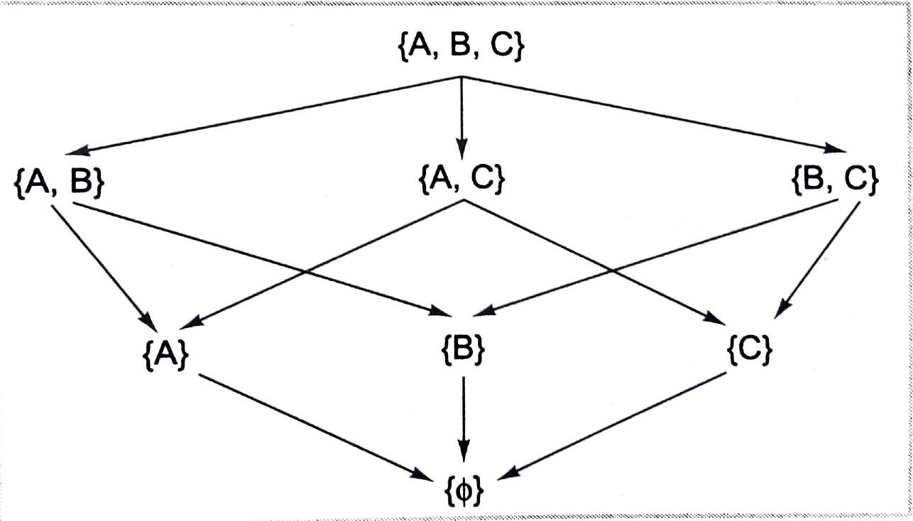
Dempster’s Rule of Combination
Lattice Subset of U = { A, B, C}

Slide 59
Dempster’s Rule of Combination
Combination of m1 and m2 | m2({A,C})=0.6 | m2({B,C})=0.8 | m2(U)=0.4
m1({A,B})=0.4 | m3({A})=0.24 | m3({B})=0.32 | m3({A,B})=0.16
m1(U)=0.2 | m3({A,C})=0.12 | m3({B,C})=0.16 | m3({U})=0.08
Joint Belief of m1 and m2 Example of a diagnostic system
Suppose we have mutually exclusive hypotheses represented by U={flu,measles,cold,cough} , Assume m(U)=1
Suppose we acquire evidence(say fever) that supports the correct diagnosis in the set {flu, measles} with its corresponding m value as 0.8 Then we get m({flu, measles})=0.8 and m(U)=0.2

Slide 60
Dempster’s Rule of Combination
Example of a diagnostic system
Two belief functions m1 and m2 based on the evidence of fever and headache m1({flu, measles})=0.8
m1(U)=0.2
m2({flu, cold})=0.6 m2(U)=0.4
Value of m3
Combination of m1 and m2 | m2({flu, cold})=0.6 | m2(U)=0.4
m1({flu, measles})=0.8 | m3({flu})=0.48 | m3({flu, measles})=0.32
m1(U)=0.2 | m3({flu,cold})=0.12 | m3({U})=0.08

Slide 61
Dempster’s Rule of Combination
Example of a diagnostic system
Further if we have another evidence function m4 of sneezing with the following belief values:Two belief functions m1 and m2 based on the evidence of fever and headache m4({cold, cough})=0.7
m4(U)=0.3
Value of m5
Combination of m3 and m4 | m4({cold, cough})=0.7 | m4(U)=0.3
m3({flu})=0.48 | m5(ϕ)=0.336 | m5({flu})=0.144
m3({flu,cold})=0.12 | m5({cold})=0.084 | m5({flu,cold})=0.036
m3({flu,measles})=0.32 | m5(ϕ)=0.224 | m5({flu,measles})=0.096
m3({U})=0.08 | m5({cold,cough})=0.056 | m5(U)=0.024

Slide 62
Dempster’s Rule of Combination
Example of a diagnostic system
Total belief for empty set (ϕ) is 0.56
We have to scale down the remaining values of non-empty sets by dividing a factor (1-
0.56=0.44) Hence, the final belief values may be written as:
m5({flu})
m5({cold})
m5({flu,cold})
=(0.144/0.44)=0.327
=(0.084/0.44)=0.191
=(0.036/0.44)=0.082
m5({flu,measles}) =(0.096/0.44)=0.218 m5({cold,cough}) =(0.056/0.44)=0.127 m5(X) =(0.024/0.44)=0.055
Therefore we have seen that degree of belief to a set will keep on changing if we get more evidences supporting or opposing it

Slide 63
Dempster’s Rule of Combination
Handling different situations
If we get an empty set (ϕ) by intersection operation, then we have to redistribute any belief that is assigned to ϕ sets proportionately across non-empty sets using the value
1 – ∑_{𝐀⋂𝐁=ϕ}(𝐦𝟏 𝐀 ∗ 𝐦𝟐(𝐁)) in the denominator of belief values for non-empty sets
While computing a new belief, we may obtain same subset generated from different intersection process. The value m for this set is computed by summing all such values

Slide 64
Belief and Plausibility
The term belief (or support) of a set A denoted by bel(A) may be defined formally as follows:
Definition: Belief is the sum of all masses of subsets of set A of interest and may be expressed as:
bel(A)= ∑ 𝐦(𝐁) , ∀B ⊆ A
For example, if X = {A,B,C}, then
bel(X) =m(A)+m(B)+m(C) +m({A,B}) +m({A,C}) +m({B,C}) +m({A,B,C})
In Dempster’s theory, a belief interval can also be defined for a subset A. It is represented as sub-interval [bel(A),pl(A)] of [0,1], where pl(A) is called plausibility of A
Definition: The plausibility may be formally defined as the sum of all masses of the sets B that intersect the set of interest A. It may be expressed as:
pl(A) = ∑ 𝐦(𝐁) , ∀B such that B⋂ A ≠ ϕ
Precise probability of a set of interest, say P(A) : bel(A)≤ P(A) ≤ pl(A)

Slide 65
Belief and Plausibility
Some important results are:
pl(A) ≥ bel(A)
pl(ϕ) = bel(ϕ) =0
bel(A) +bel(~A) ≤ 1
pl(A)+pl(~A) ≥ 1
bel(U) = pl(U) =1
pl(A) +bel(~A)=1 [pl(A) =1-bel(~A)]
Dempster and Shafer suggested use of the interval[bel(A),pl(A)] to measure uncertainty of A

Slide 66
Belief and Plausibility
For example: Suppose for the proposition The Car is Stolen, we have belief of 0.6 and a plausibility of 0.8, that is we have evidence that the proposition is true with a confidence of 0.6. The evidence of Car is not stolen is 0.2 (bel(~A) = 1 – pl(A))
Then remaining mass of 0.2 (the gap between supporting evidence and contrary evidence
i.e. 1-(0.6+0.2)= 0.2 is indeterminate implying that the car may or may not be stolen
Hypothesis | Mass | Belief | Plausibility
Null (neither stolen or not stolen) | 0 | 0 | 0
Car stolen | 0.6 | 0.6 | 0.8
Car not stolen | 0.2 | 0.2 | 0.4
Either(stolen or not) | 0.2 | 1.0 | 1.0
Mass, Belief and Plausibility values of Hypothesis

Slide 67
Belief and Plausibility
The null hypothesis is set to zero by definition as it corresponds to no solution
The hypotheses stolen and not stolen have degree of belief (mass) of 0.6 and 0.2, respectively
Finally Either hypothesis gets value of 0.2 so that the sum of the masses is 1
The belief for the stolen and not stolen hypotheses matches their corresponding masses because they have no subsets
Belief for Either consists of the sum of all three masses (Either, stolen and not stolen) =
1.0 because stolen and not stolen are each subsets of Either
The plausibility for stolen is 1-m(not stolen) = 1.0-0.2 =0.8 and for ‘not stolen’ is 1- m(stolen)=1.0-0.6=0.4
Plausibility for Either is the sum of m(stolen)+m(not stolen)+m(Either)=1.0
The universal hypothesis (Either) will always have 100% support and plausibility

Slide 68
Advantages of Dempster Shafer Theory
Prior and conditional probabilities need not be specified in Dempster –Shafer framework
Any information contained in the missing prior and conditional probabilities is not used in the Dempster –Shafer framework unless it can be obtained indirectly. D-S Theory allows one to specify a degree of ignorance in this situation instead of being forced to supply prior probabilities which add to unity

Slide 69
Textbook:
1. Artificial Intelligence, Saroj Kaushik, 1st Edition, Cengage Learning
Reference Books:
Artificial Intelligence, Elaine Rich, Kevin Knight, Shivashankar B Nair, 3rd Edition, Tata McGraw Hill Education Private Limited., 2009
Artificial Intelligence- A modern Approach, 3rd Edition, Stuart Russel, Peter Norvig, Pearson Education
57

